Slide 1
Revolutionizing Personal Finance with Smart Technology for Enhanced Budgeting Efficiency - Budget Buddy -
Author: Șipoș Lucas-George
Supervisor: Conf. dr. Craciun Florin

Slide 2
Table of contents
Introduction
Money management
Key features
Countries that use it
1
2
3
4

Slide 3
Introduction
1
Evolution of expense tracking over time

Slide 4
Expense tracking over time
Excel; more organized, “automated”, reduction of paper consumption
On the go tracking, multiple devices, decreased local memory
Handling immense data slow, time-consuming set-up, security
Rely on a server, data privacy
Era of Spreadsheets
Web Revolution
Era of paper logs
Specialized Software
The only way to keep track of expenses
Increased security, data handling; reduced errors, set-up time
Easy to be lost, manipulated, damaged; time-consuming
Local memory usage, not on the go

Slide 5
Money management
2
Strategy & Customizations

Slide 6

50/30/20 Rule
Book:
“All Your Worth: The Ultimate Lifetime Money Plan”
Wants
Needs
Saves

Slide 7


Senator Elizabeth Warren
Amelia Warren Tyagi

Slide 8
Customizations

Slide 9
Annually | Individual earnings ($) | Essentials (%) | Debt Repayment (%) | Discretionary Spending (%) | Savings (%)
 | Household earnings ($)
 | <25k | 60-70 | 10-15 | 5-20 | 10-15
 | <40k
 | 25k-75k | 50-60 | 10-20 | 10-20 | 20-30
 | 40k-125k
 | 75k-200k | 40-50 | 5-10 | 10-15 | 30-40
 | 125k-250k
 | >200k | 30-40 | 0-10 | 10-30 | 40-50
 | >250k

Slide 10
Key features
3
What makes Budget Buddy stand out

Slide 11
Customizable Budget Setting
Income
Essentials
Discretionary Spending
Savings
Debt Repayment
Status
Currency

Slide 12
Expense and Subscription Recording
Easy to add and update/delete multiple expenses at once
Easy to search with tons of search possibilities on every field
Hide any information you want to see and bring them back
Sort the data on any column you like

Slide 13
Data visualization
Is done by using donut charts and here are the 3 expense classification:
By Category
By Payment Method
By Type

Slide 14
Application
4
Let’s get down to business

Slide 15
Architecture

Slide 16
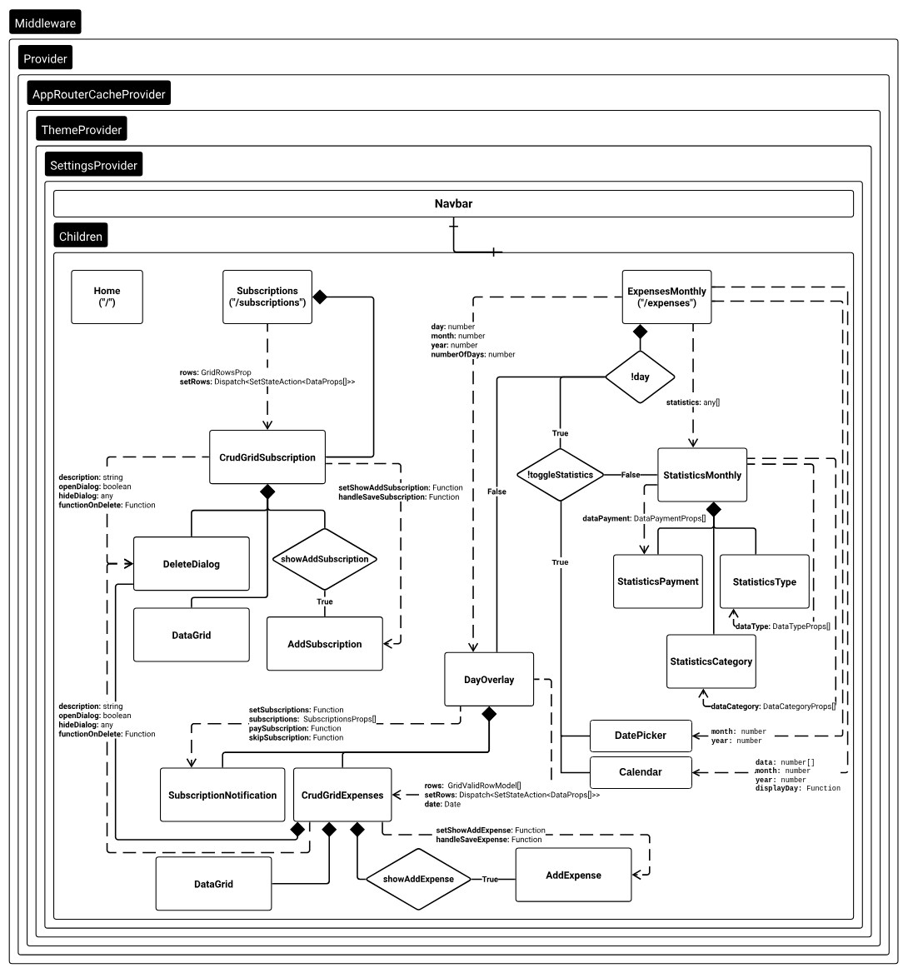

Slide 17
Summary of achievements
Cross-device accessibility, real time synchronization
Free of charge, no subscriptions needed
User-centric design to satisfy a wide range of clients
Enhancing financial literacy ensuring rational monetary decisions

Slide 18
Thank you!

